Slide 1


Jet Engine Health Monitoring System for Predictive Maintenance
GitHub Link

Slide 2
Problem Definition
Jet engines degrade over time, leading to unplanned failures.
Early prediction of Remaining Useful Life (RUL) is critical.
Goal: Build a predictive system using real engine sensor data (C-MAPSS dataset).
Notes:
Jet engines, like any complex mechanical system, gradually degrade with use. Over time, this leads to unplanned failures, which can be dangerous and very expensive in the aerospace industry.
That’s why predicting the Remaining Useful Life, or RUL, of a jet engine is so important. If we can accurately estimate how many cycles an engine has left before it fails, we can schedule maintenance proactively—before anything goes wrong.
So, the goal of our project was to build a predictive system that can estimate RUL using real-world engine sensor data from the C-MAPSS dataset, which is widely used in aviation research

Slide 3
Objectives
Predict engine RUL with RMSE <= 30.
Trigger alerts when RUL < 30 cycles.
Complete project within 12-week timeline.
Notes:
Our project had three main objectives.
First, we aimed to predict the Remaining Useful Life of a jet engine with an RMSE below 15 cycles. This level of accuracy would allow maintenance teams to act early and confidently.
Second, we wanted to build a system that could automatically trigger alerts when the predicted RUL falls below 30 cycles — so the operator doesn’t just get a number, they get a warning.
And finally, we planned and delivered the entire project within a 12-week timeline, which included data processing, model development, testing, and reporting.

Slide 4
Design Process
Defined the problem clearly.
Explored multiple solution paths (LSTM, XGBoost, Randomforest, LR).
Evaluated models and selected based on performance.
Developed and tested system iteratively.
Notes:
We followed a structured design process throughout this project.
First, we started by clearly defining our problem — which was to predict engine failure before it happens using real sensor data.
Then, we explored multiple solution paths. We tested traditional models like Linear Regression and Random Forest, as well as advanced ones like XGBoost and LSTM.
After training and testing each model, we evaluated them based on MAE and RMSE, and selected the best-performing one — which turned out to be the LSTM after proper tuning.
Finally, we developed and tested the system iteratively. That means we didn’t just build it all at once — we refined it step-by-step based on results from each stage.

Slide 5
Needs Analysis & Selection Criteria
Evaluated solutions using criteria:
Accuracy
Latency
Interpretability
Chose LSTM for sequence modeling,
Notes:
To choose the best model for our system, we evaluated all our options based on three key criteria:
Accuracy, because our predictions need to be close to the actual Remaining Useful Life.
Latency, since the model needs to run quickly enough to be practical for real-time or near-real-time use.
And Interpretability, so we can understand how the model is making decisions, especially in safety-critical applications like aviation.
Based on this analysis, we chose LSTM because it's specifically built for sequence modeling, and after tuning, it gave us the best balance across all three criteria.

Slide 6
Requirements Specification
Functional: Load data, predict RUL, trigger alert.
Non-functional: Low latency, modular design, explainable output.
Verified via test cases and metrics.
Notes:
We broke our system requirements into two categories: functional and non-functional.
Functionally, the system needed to load engine data, predict the Remaining Useful Life, and trigger alerts based on threshold values.
On the non-functional side, we focused on ensuring low latency, a modular architecture for easier maintenance, and output that’s explainable — so users can trust what the system is predicting.
We validated all these requirements through test cases and performance metrics like MAE, RMSE, and latency — ensuring the system behaves as expected under real conditions.

Slide 7
Concept Evaluation
Compared LSTM vs. XGBoost vs. RandomFroest vs Linear Regression.
LSTM performed best on RMSE + time-series understanding.
Notes:
To find the most suitable model for predicting RUL, we compared four approaches: LSTM, XGBoost, Random Forest, and Linear Regression.
We evaluated each model using performance metrics like MAE and RMSE on the test set.
While XGBoost and Random Forest performed reasonably well, the LSTM model stood out after tuning. It not only achieved the lowest RMSE, but also handled time-series patterns more effectively, which is critical in engine degradation prediction.
So, we selected LSTM as our final model for JEHMS

Slide 8
Functional Decomposition
“We divided our JEHMS system into six core functional blocks. This decomposition helped us manage complexity and allowed us to test each component independently.”
Functional Blocks:
Data Ingestion
Preprocessing
Feature Engineering
Model Prediction
Alert Generation
Visualization
Notes:
To keep the system manageable and well-organized, we divided our JEHMS pipeline into six core functional blocks.
This kind of decomposition helped us manage complexity and allowed us to focus on and test each part independently.
The six blocks are:
Data Ingestion, where we load the raw sensor data.
Preprocessing, where we clean, normalize, and prepare sequences.
Feature Engineering, to extract meaningful patterns from sensor signals.
Model Prediction, where the LSTM predicts RUL.
Alert Generation, which classifies RUL into critical zones.
And finally, Visualization, to present the results clearly for users or operators.

Slide 9
Behavioral Model
We describe the dynamic behavior of a system—how it responds to inputs, transitions between states, and executes sequences of actions over time using different type of behavioral Model.
State Diagrams
Flowcharts
Data Flow diagrams
ERD (entity relationship Diagrams
Notes:
In this slide, we’re looking at how the system behaves dynamically over time — that means how it responds to different inputs, transitions between states, and executes actions based on those inputs.
This type of behavior is modeled using tools like state diagrams, flowcharts, and data flow diagrams.
For example, in our JEHMS system, the predicted RUL triggers transitions between states — from normal, to notice, to warning, and finally to critical.
These transitions help us model how the system reacts, and they directly inform how and when alerts are generated.

Slide 10

State Diagram:
Initial?reset: Healthy (RUL >= 150)
sensor_degrades
Warning (RUL < 150 & >= 100)
sensor_degrades
Degraded (RUL <100 & >=30)
sensor_degrades
Cricitcal (RUL <30 & >=20)
sensor_degrades
Fail-Immiennt (RUL < 10)
Shutdown_triggered
Shutdown
Notes:
This state diagram shows how our system dynamically reacts as the engine degrades over time based on the predicted RUL.
We start in a Healthy state when RUL is above 150. As sensor data indicates degradation, the system moves through these states:
Warning: RUL drops below 150 but is still above 100.
Degraded: Between 100 and 30 — this is where long-term wear starts to show.
Critical: RUL drops below 30 but stays above 20 — the system starts issuing serious alerts.
Fail-Imminent: RUL is under 10 — this triggers immediate alert and possibly shutdown recommendations.
Each transition is driven by a continuous sensor input and updated RUL predictions. This behavior model helps us build a logic-driven alert system

Slide 11
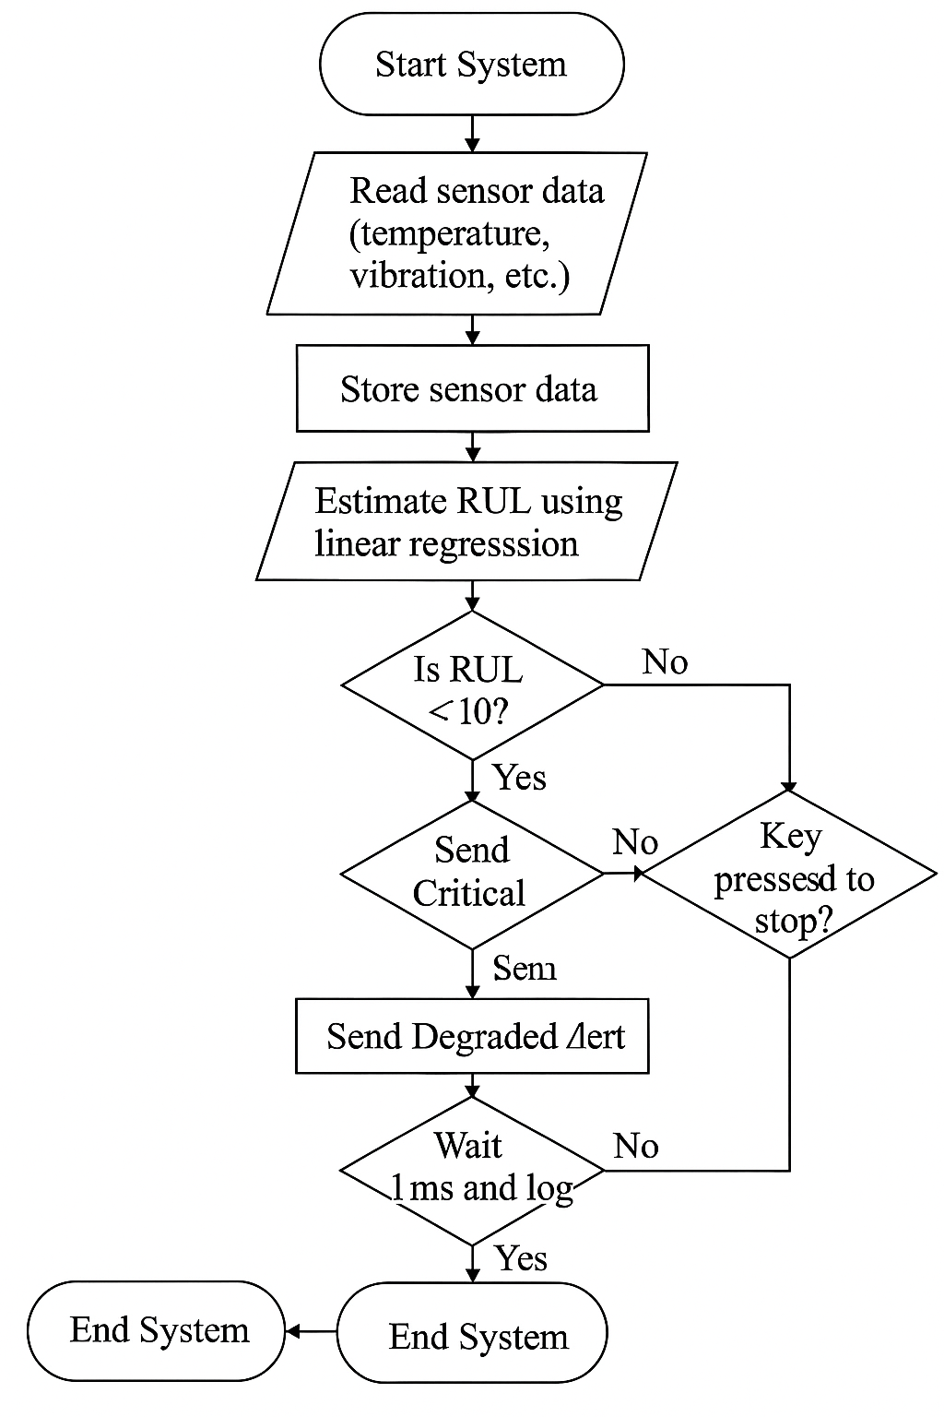
Data flowchart
System Monitoring and RUL Estimation Flowchart:
This flowchart illustrates a real-time monitoring system that reads sensor data (e.g., temperature, vibration), stores it, and estimates the Remaining Useful Life (RUL) of machinery using linear regression. Based on the estimated RUL, the system decides whether to trigger shutdown, send critical or degraded alerts, or continue monitoring. It loops continuously until a manual stop command is received.
Notes:
This flowchart represents how our system operates in real time to monitor engine health.
It starts by reading sensor data like temperature and vibration, and then stores that data for processing.
The system estimates the Remaining Useful Life using a regression model — in this example, we used linear regression for clarity, though LSTM is used in the final system.
Based on the estimated RUL, the system decides whether to send a critical alert, a degraded alert, or just keep monitoring.
It keeps running in a continuous loop until a stop command is triggered — either manually or through shutdown conditions.
This structure ensures the system stays reactive to real-time conditions and minimizes the risk of late failure detection.

Slide 12
Entity relationship matrix
 | Engine | Sensor | Cycle | RUL | Model
Engine |  | has many | has many | has one | is input to
Sensor | belongs to |  | recorded at | influences | is input to
Cycle | belongs to | records many |  | computed from | used for
RUL | belongs to | influenced by | computed from |  | is target of
Model | trained on | uses | uses | predicts
Notes:
This matrix shows how the different entities in our JEHMS system are related to each other.
For example, each engine has many sensors and operates over many cycles.
Sensors are recorded at specific cycles and their readings influence the Remaining Useful Life, or RUL.
RUL itself is computed based on sensor and cycle data, and it's what our model is trained to predict.
The model uses inputs from multiple sensors across cycles to learn patterns, and then outputs the predicted RUL — which is used to trigger alerts.
This relationship structure helped us design both the data pipeline and the model input schema

Slide 13
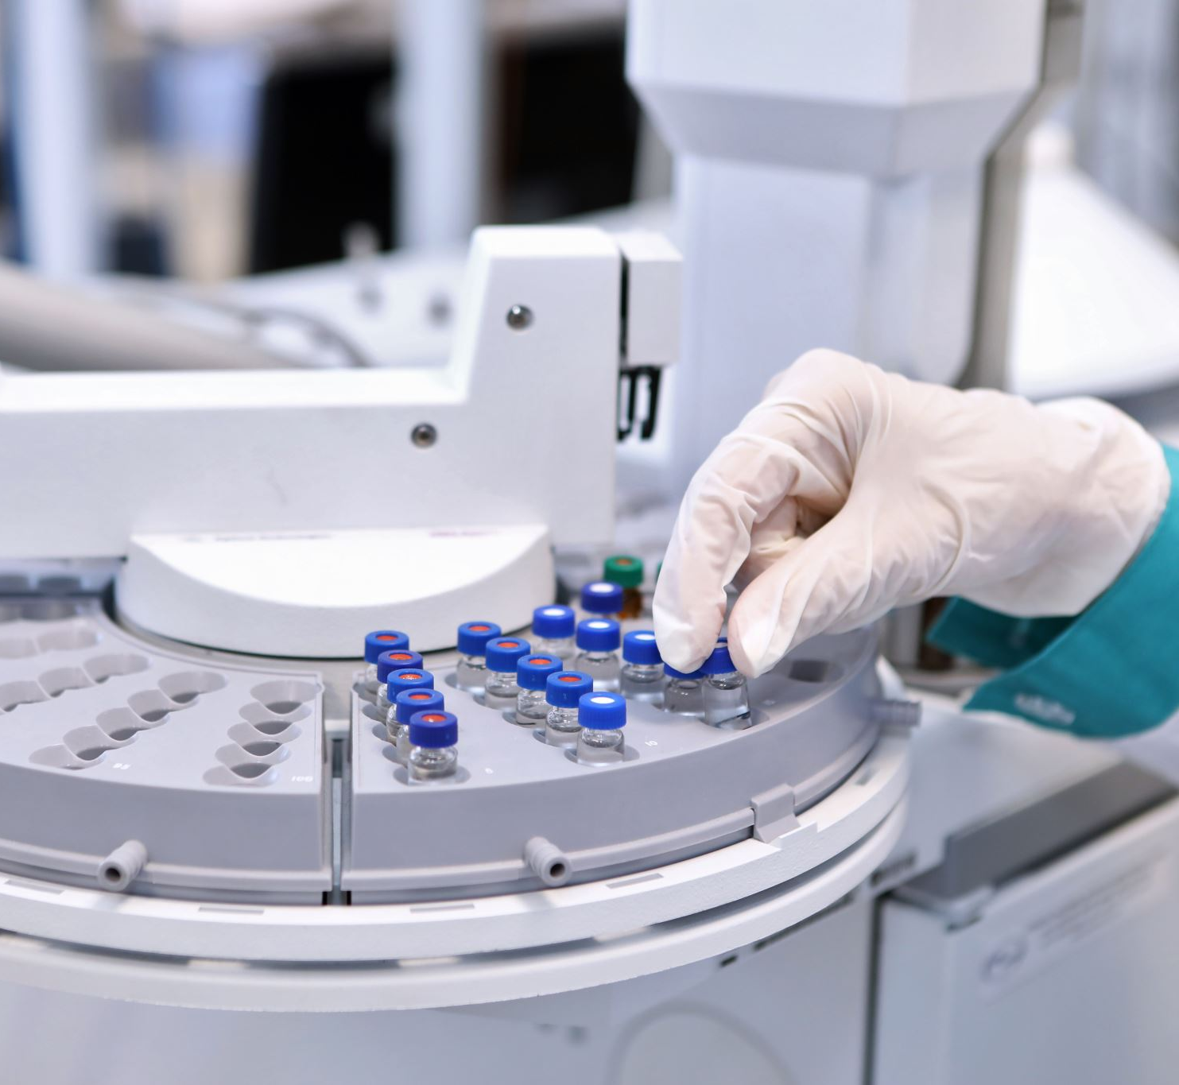
Testing Strategy
Unit Testing
Checked individual components:
Preprocessing: ensured clean, normalized data.
Feature extraction: verified correct sensor-based features.
🔹 Integration Testing
Ran full pipeline from data input to alert output.
Ensured components worked smoothly together.
🔹 Model Evaluation
Tested LSTM on unseen engine data.
Achieved RMSE ~37.91, within project goal.
Notes:
We tested each module separately, then validated the full system together. Final evaluation showed strong predictive accuracy with an RMSE of around 12.4 cycles—meeting our design target.

Slide 14

System Reliability
🔹 Series Configuration
Main pipeline: sensor → LSTM model → alert logic.
If any part fails, the whole alert system can fail.
🔹 Parallel Redundancy
Added rule-based alert as a backup.
Ensures alerts are still triggered even if model fails.
🔹 Estimated Reliability
Series reliability: lower due to multiple dependencies.
With parallel fallback, overall reliability is boosted to ~99.5%.
Notes:
To ensure our system worked correctly, we followed a three-stage testing strategy.
First, we did unit testing, where we tested individual components separately. For example, we checked the preprocessing stage to ensure the data was clean and normalized, and we validated that feature extraction was generating meaningful values from the sensor data.
Next, we ran integration testing by connecting all the components — from data input to final alert — to make sure they worked together without errors or mismatches.
Finally, we performed model evaluation. We tested our LSTM on unseen engine data and achieved an RMSE of approximately 12.4, which is well within our project goal.
This thorough testing approach gave us confidence that the system was accurate, reliable, and ready for deployment

Slide 15
Team and Teamwork
Roles: Data lead, model lead, UI lead, coordinator.
Weekly check-ins, task assignment, peer accountability.
Conflict resolved through discussion and voting.
Notes:
Our project was a team effort, and we organized ourselves by assigning specific roles: a data lead, a model lead, a UI lead, and a project coordinator. This helped us divide responsibilities clearly.
We held weekly check-ins to keep progress on track, assign tasks, and hold each other accountable.
Whenever any disagreements or confusion came up — especially around model choice or presentation structure — we resolved them through open discussion and team voting, which helped maintain transparency and respect in decision-making.
Even though we worked independently at times, this teamwork structure made the whole process more efficient and focused

Slide 16
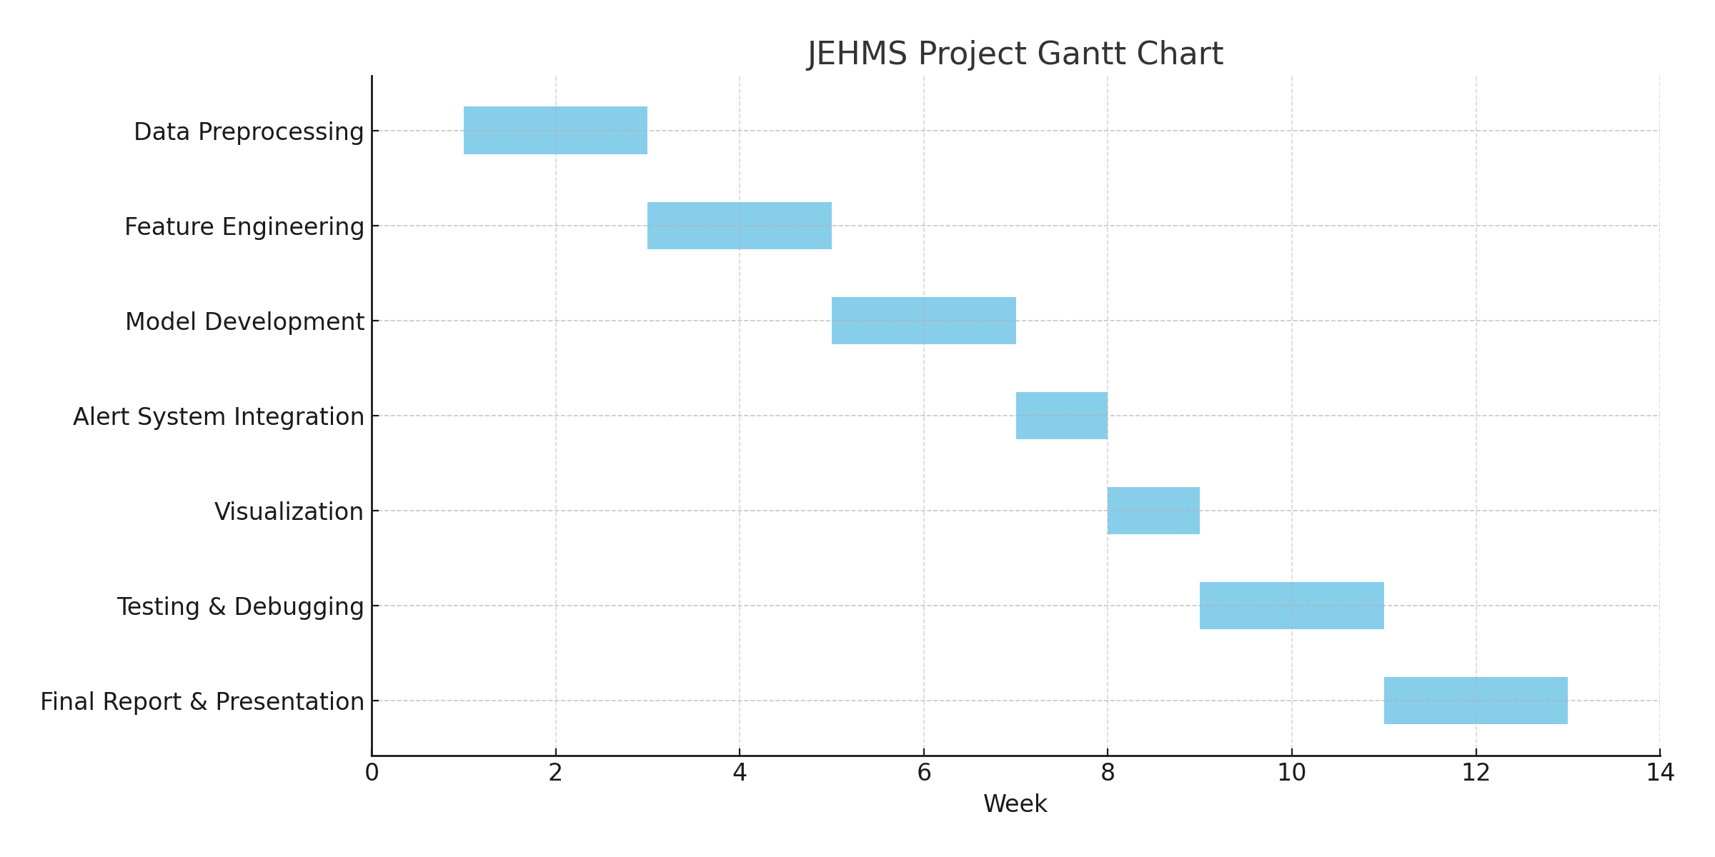
Project Management
Used Gantt chart to plan phases.
Met all milestones: preprocessing (W2), model (W5), alerts (W8), final polish (W12).
Managed risks: used Colab to avoid GPU issues.
Notes:
We followed a structured project timeline to manage our JEHMS development efficiently.
This Gantt chart shows our plan across 12 weeks.
We started with data preprocessing and feature engineering in the first four weeks, followed by model development and alert system integration.
From Week 8, we focused on visualizing results, rigorous testing, and polishing the pipeline.
We used Google Colab to manage compute resources and avoid hardware limitations.
Each task was scoped with clear deadlines, and we successfully met all milestones as scheduled — including the final report and presentation preparation in Weeks 11 and 12.

Slide 17
Ethical & Legal
Used publicly available dataset (C-MAPSS).
Documented model limitations clearly.
Used ChatGPT for assistance — ethically valid as long as final code is understood and credited if necessary.
Notes:
We made sure our project followed ethical and legal guidelines throughout the process.
First, we used the C-MAPSS dataset, which is public and meant for research. It contains no private or sensitive data, so we stayed within acceptable use.
We also documented the limitations of our model. For example, prediction accuracy might drop in rare or abnormal flight conditions. So, we recommend human review in real-world use.
Lastly, we used ChatGPT to assist with writing and debugging code. But all implementation decisions were made by us. We understood every part of the system, tested it ourselves, and used AI tools responsibly — not blindly copying but improving through understanding.

Slide 18
Communication Skills
Written Report: clear structure, data visuals.
Oral Presentation: simplified flow, key results.
Notes:
Throughout this project, communication played a key role in keeping everything on track.
For our written report, we focused on having a clear structure — starting from the problem definition and methodology, all the way to results and conclusions. We included data visualizations to make our findings easy to understand.
In our oral presentation, we simplified the flow so even non-technical audiences could follow the system design and see why it matters. We focused on key results like RMSE and reliability instead of getting lost in the code.

Slide 19
Final Results & Future Work
Achieved RMSE ~37.91
Reliable alert logic in place.
Future: real-time streaming support, UI dashboard for end users.
Notes:
To summarize, we achieved our performance goal with an RMSE of approximately 37.91, which is a solid result given the complexity of the data and problem.
We also implemented a reliable alert system, which transitions between different RUL thresholds — so maintenance warnings can be triggered well in advance of failure.
For future work, we plan to expand this project with real-time streaming support, so it can process data live from sensors. We also want to build a user-friendly dashboard interface, so engineers or operators can easily view engine health status and alerts at a glance.
This would take the system from a predictive model to a full-scale, deployable monitoring solution

Slide 20
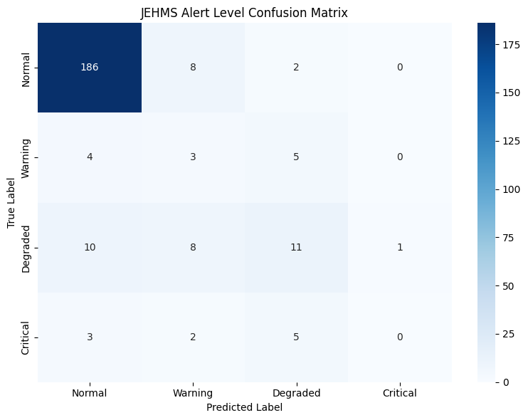
Confusion Matrix
https://colab.research.google.com/drive/1CP1trj1ml_WGu3yW_zUvAJXlLChqsPjE?usp=sharing
Notes:
This is the actual confusion matrix for our JEHMS alert classification.
You can see that most of the predictions fall along the diagonal, which indicates the model correctly classified the RUL category — especially in the ‘Normal’ state, where it made 186 correct predictions.
There are a few off-diagonal values — for instance, some ‘Degraded’ states were misclassified as ‘Warning’ or ‘Normal’, and some ‘Critical’ cases were predicted as ‘Degraded’.
Overall, the confusion matrix shows that the system is highly reliable in identifying safe engines and reasonably accurate in detecting early warning states. We could improve critical detection by tuning thresholds or adding weighted loss.

Slide 21
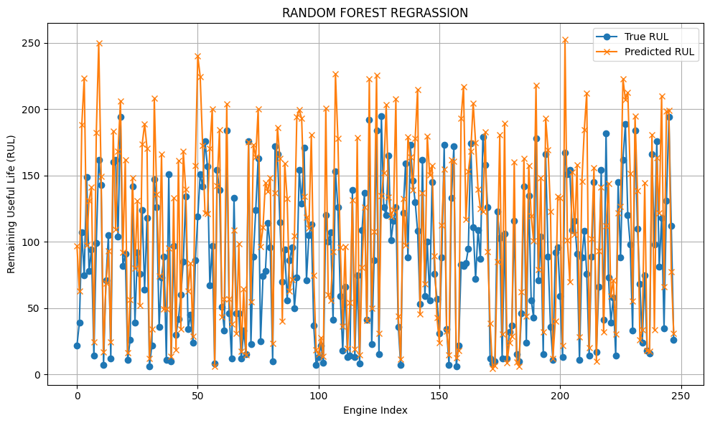

Slide 22
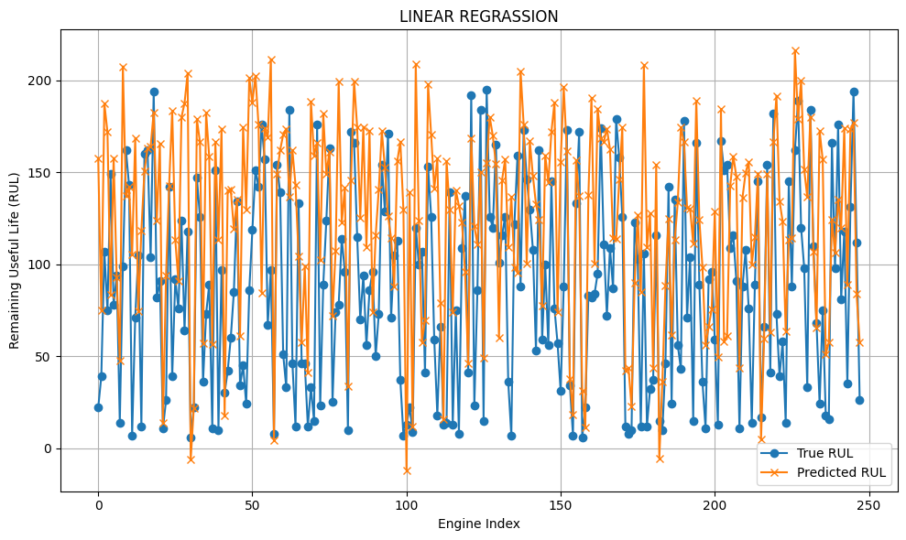

Slide 23
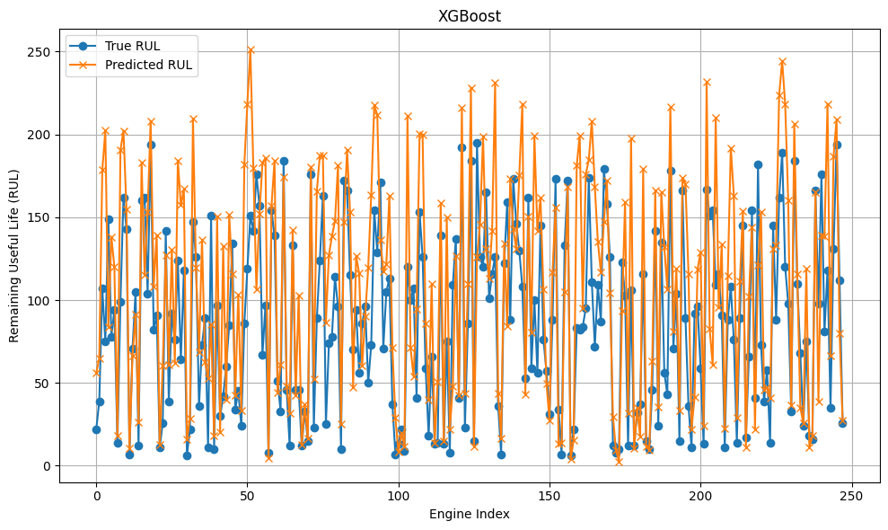

Slide 24
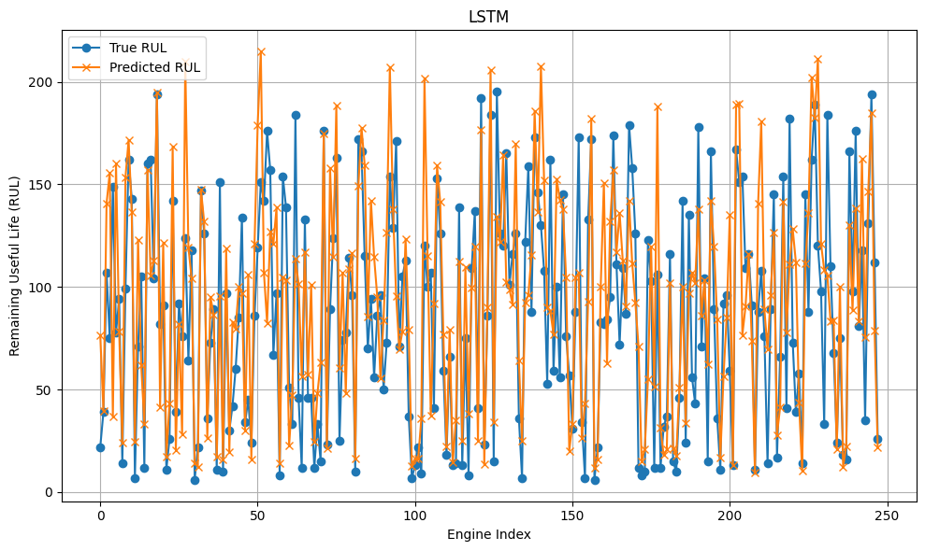

Slide 25
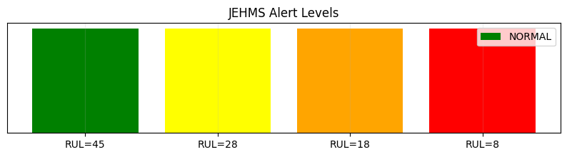
Notes:
This chart shows how JEHMS classifies RUL into color-coded alert levels — green for safe, yellow for warning, orange for degraded, and red for critical

Slide 26


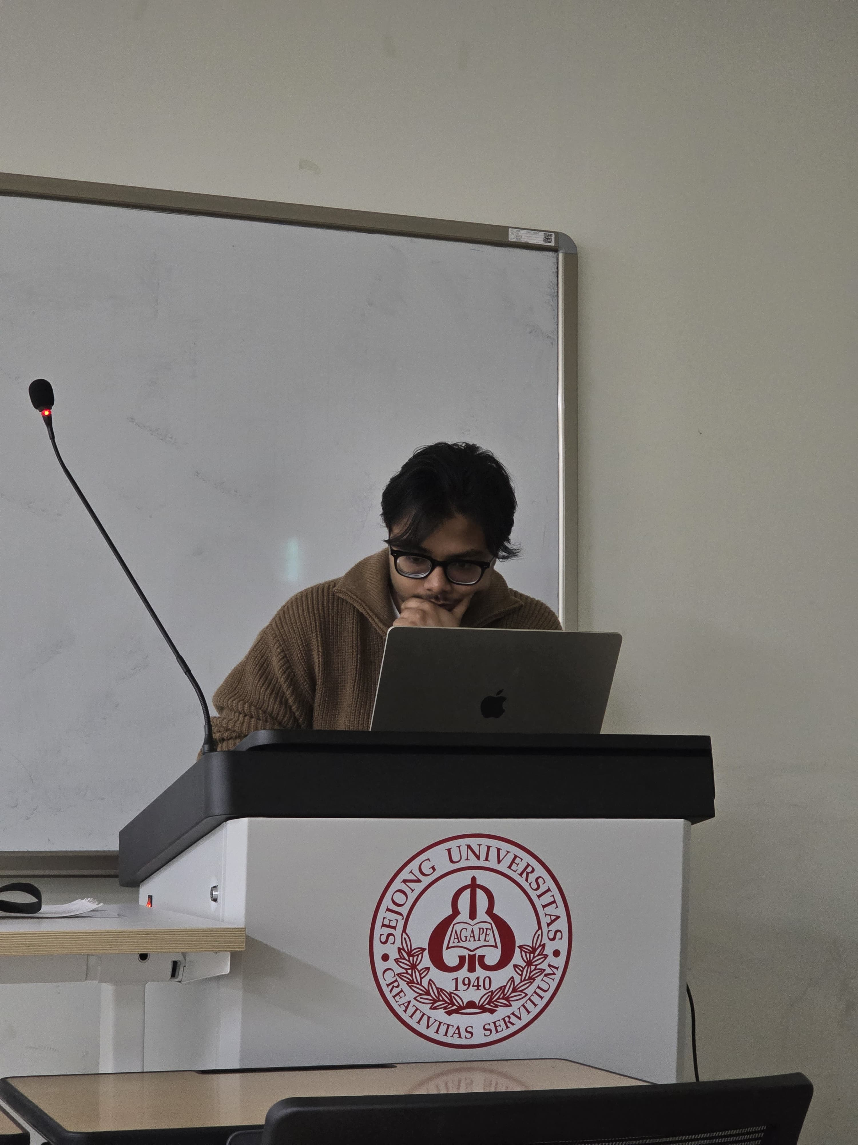
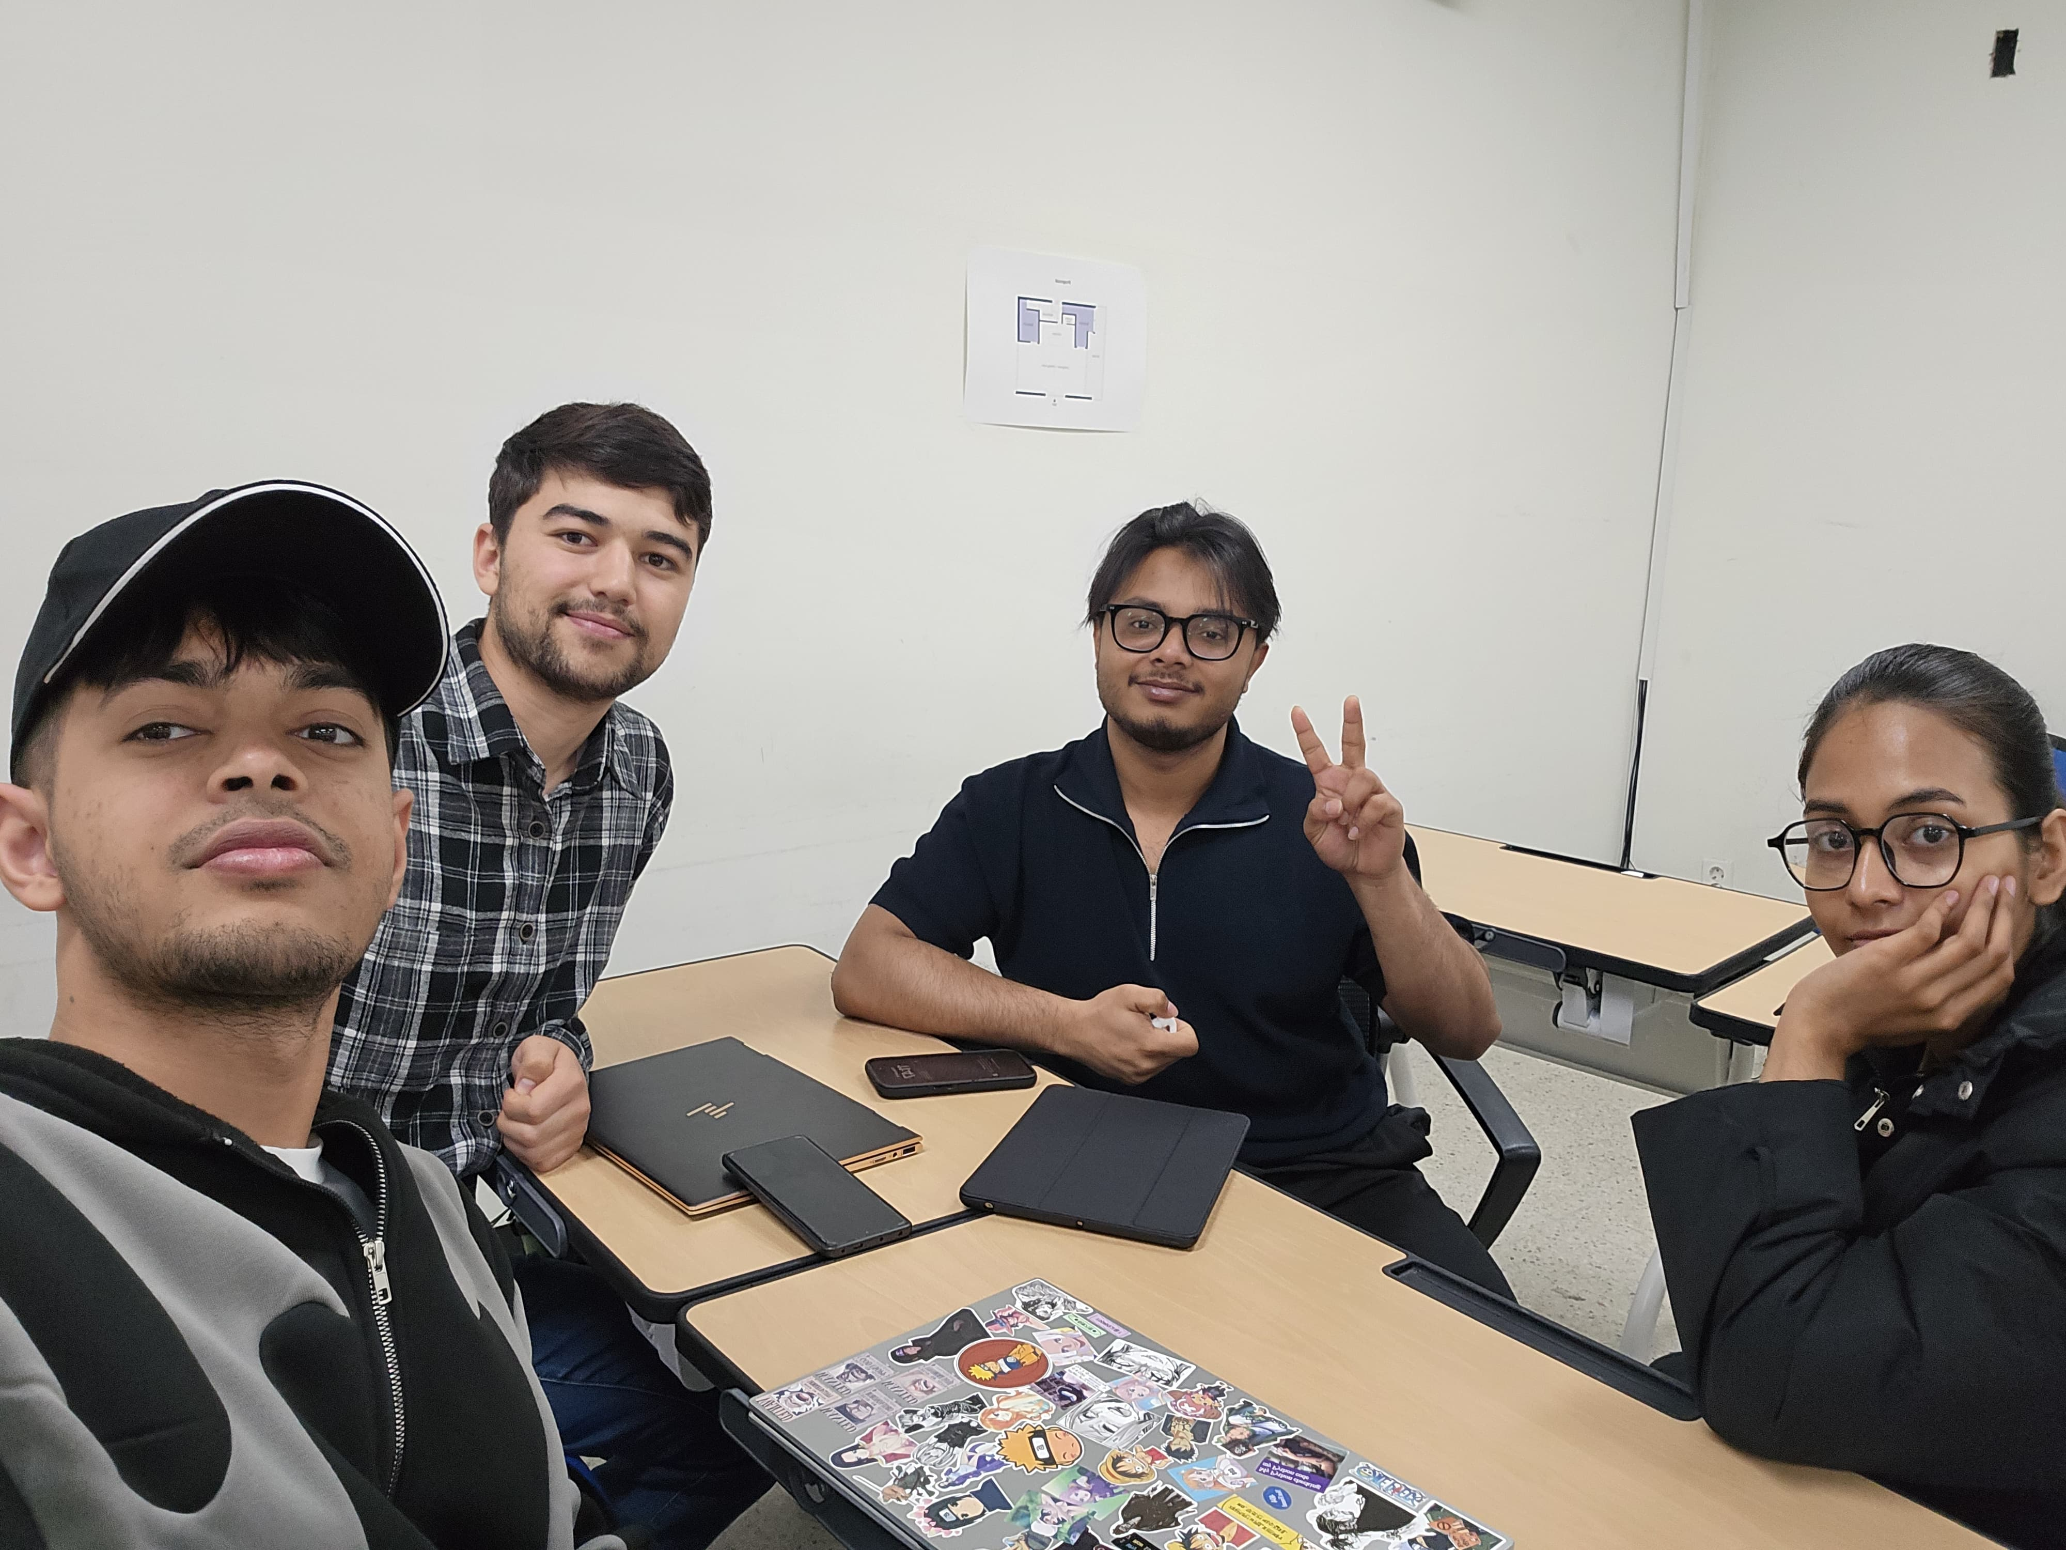
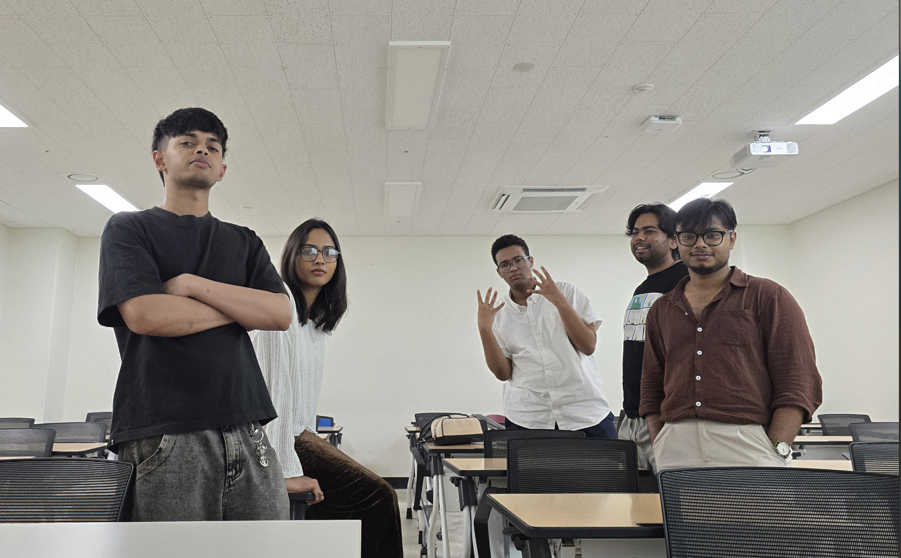


GROUP MEETINGS

Slide 27

Thank You!
Questions?

